Slide 1

STRENGHTENING OF EXPANSIVE SOILS BY USING RICE HUSK ASH AND COCONUT COIR FIBRE
RESERACH GROUP-GEOTECHINICAL ENGINEERING
BATCH ID:15IEGTE04 UNDER THE GUIDANCE OF
Mr. N. SANDEEP KUMAR
ASST. PROFESSOR
DEPARTMENT OF CIVIL ENGINEERING
K L UNIVERSITY
PRESENTED BY:
K .VENKATA SAI - 160020046
M. SAI NANDAN - 160020067
P. RAKESH - 160020088

Slide 2
CONTENTS :
ABSTRACT
INTRODUCTION
MATERIALS USED
METHODOLOGY
TESTS PERFORMED
PHYSICAL PROPERTIES
ENGINEERING PROPERTIES
RESULTS
CONCLUSION
REFERENCES

Slide 3
OBJECTIVES:
THE OBJECTIVE OF THIS INVESTIGATION IS TO STUDY THE STABILIZATION OF RED SOIL BY USING RICE HUSK ASH AND COCONUT COIR FIBRE .
1. To study the following physical properties of soil by mixing it with different percentages of Coir fibre & Rice husk ash
A)Optimum moisture content
B)Maximum dry density
C)Unconfined compressive strength

Slide 4
ABSTRACT :
Clay soil is typically expansive soil have inherent property if swelling when they are dried and swelling when water is absorbed.For any structure , foundation is very important and it is strong to support the entire structure.
Rice husk ash is a waste obtained from edge of rice. The use of natural coir fibre to reinforce soil is an ancient method. So we use these two materials to improving characteristics of clay type of soils.

Slide 5
INTRODUCTION :
Soil stabilization is required when the soil available for construction is not suitable for the intended purpose.
This study, particularly aims at testing the viability of utilizing waste materials such as Rice Husk Ash and Coir Fiber which are eco-friendly as well as economical, for soil stabilization.
For instance, Rice husk ash and the Coconut coir fibre which is used for various civil engineering application of stabilization and other geotechnical construction works.
soil stabilization has been done with the help of rice husk ash and randomly distributed waste coir fibers .

Slide 6
MATERIALS USED:
RICE HUSK ASH
COCONUT COIR FIBRE
RED SOIL
(1). RICE HUSK ASH :: Rice husk is a material obtained from the rice milling plants after the rice is isolated. It is a natural material and by product of the agriculture, the cheapest and pollution free material. It improves the compressive strength and the bearing capacity of soil. RHA is a good reactive material to cement in construction and known as alternate cement.
(2). COCONUT COIR FIBRE:This fibrous material is naturally obtained from the environment. It is relatively a waterproof material and, is one of the few natural fibres which can resist the damage of salt water. Coconut coir Fiber is separated from the husk of coconut and utilized in items example, Ground mats and Doormats. Coir Fiber is the fibrous material found in the middle of the hard, inner shell and the external layer of a coconut.
(3). RED SOIL: The soil is formed when rocks are broken down by the action of wind, water and climate. This process is called weathering. The red soils are formed due to weathering process by wind, water and nature due to weathering of the igneous rock. The water holding or water absorbing capacity of these soils is less. The red soil required for the experiments is collected from the village vaddeswaram to KL University. The red soil is carried out to the laboratory in bag.

Slide 7
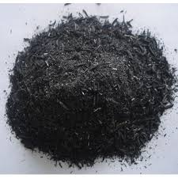
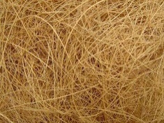
AD-MIXTURES:
RICE HUSK ASH Fig 1.0
COCNUT COIR FIBRE Fig 2.0

Slide 8
METHODOLOGY :
.
COMPARISON OF RESULTS
LITERATURE REVIEW
ENGINEERING PROEPRTIES AFFTER ADDING AD-MIXTURES
COLLECTION OF MATERIALS
PHYSICAL PROPERTIES
ENGINEERING PROPERTIES
OVERVIEW METHODS
BEHAVOIR IN DIFFERENT CONDITIONS

Slide 9
TESTS PERFORMED : PHYSICAL PROPERTIES OF SOIL :
DETERMINATION OF SPECIFIC GRAVITY
DETERMINATION OF MOISTURE CONTENT
ATTERBERG LIMITS ( LL,PL & SL)
GRAIN SIZE ANALYSIS

Slide 10
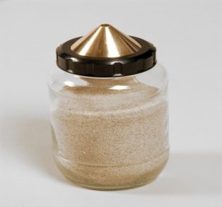
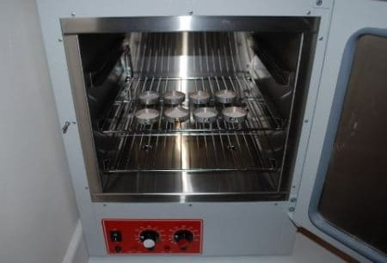
FIGURES :
SPECIFIC GRAVITY Fig. 1.0
WATER CONTENT Fig 2.0

Slide 11
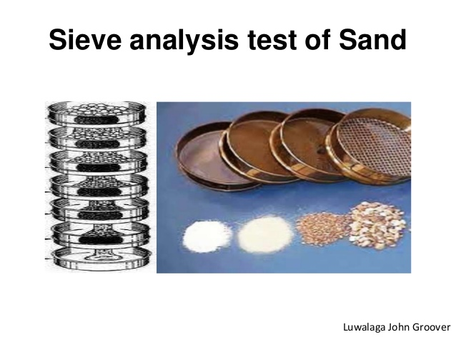
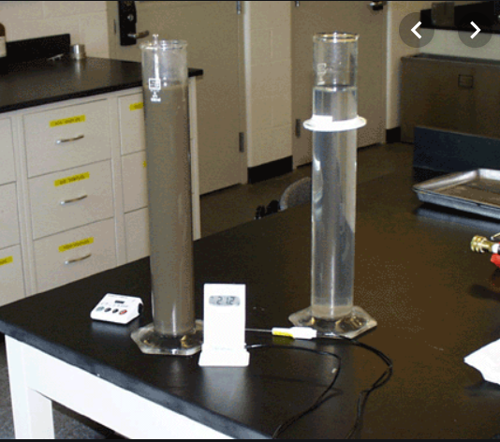
.
GRAIN SIZE ANALYSIS Fig 3.0
SWELLING CHARESTERISTICS Fig 4.0

Slide 12
ENGINEERING PROPERTIES :
PERMEABILITY TEST :
Falling head method or Variable Head Method
2. UNCONFINED COMPRESSION STRENGTH
3. CALIFORNIA BEARING RATIO TEST
4. STANDARD PROCTOR TEST
5. SWELLING CHARACTERISTICS

Slide 13

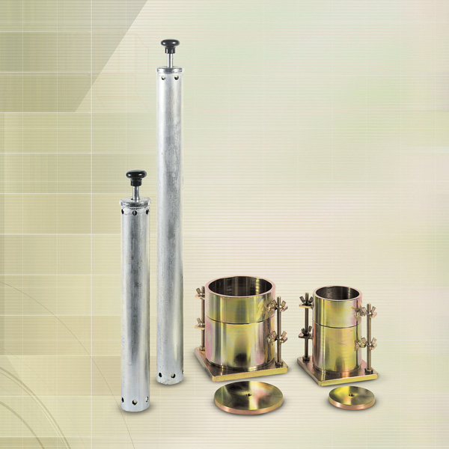
STANDARD PROCTOR Fig 5.0
UNCONFINED COMPRESIVE STRENGTH Fig 6.0

Slide 14
RESULTS TABLE: PHYSICAL PROPERTIES
NAME OF EXPERIMENT | RESULTS
FREE SWELL INDEX | 40%
SIEVE ANALYSIS | Reddish clay CH (Clay with High Compressibility)
MOISTURE CONTENT | 19.68 %
LIQUID LIMIT PLASTIC LIMIT PLASTICITY INDEX | 45% 22.6 % 22.4 %
SPECIFIC GRAVITY | 2.69

Slide 15
ENGINEERING PROPERTIES:
NAME OF THE EXPERIMENT | RESULTS
CONSTANT HEAD METHOD | 0.0115
UNCONFINED COMPRESSIVE STRENGTH | 24.5
STANDARD PROCTOR TEST MDD OMC | 16.75 12
SWELLING CHARECTERISTICS | 50%

Slide 16
CONCLUSION:
Overall it can be concluded that the rice husk ash and coir fiber can be considered to be good in ground improvement technique Especially in engineering projects on weak soils where they can act as a substitute to deep/raft foundations, reducing the cost as well as energy.
By comparing all the results of Atterberg’s limits for sample 1, it could be concluded that, maximum plasticity index, liquid limit (approx.) was achieved at 45% and also maximum plastic limit is obtained at 22.6% coconut coir fibre reinforcement. Then regarding compaction for sample 1, by comparing results from all the graphs, it could be concluded that, at 0.8% ash achieved maximum improvement of MDD and OMC.
In our experiments, the adding of RHA and coconut coir fiber increases soil strength and we got optimum value at 15%. If keep on increasing the percentage of RHA, after 15% the strength of soil decreases.

Slide 17
REFERENCES:
Gourly, C.S., Newill, D., and Shreiner, H.D., “Expansive soils: TRL’s research strategy.” Proc., Int. symp. On Engineering Characteristics of Arid soils, 1993.
Chapman, H.D., “Cation Exchange Capacity in Methods of soil analysis”, American society of Soil Agronomy, 1965, C.A. Black et al., Eds., Madison, WI, pp.891-901.
N K Bhasin, N K Goswami, P Oli, N Krishnan and N B Lal (1988), “A Laboratory Study on Utilization of Waste Materials for the Construction of Roads in Black Cotton Soil Areas”, Highway research bulletin, No. 36,pp. 1-11.

